Slide 1
TO SPANK OR NOT TO SPANK?

Slide 2
We want to hear from you!
Do you have any childhood spanking experiences that you would like to share?

Slide 3
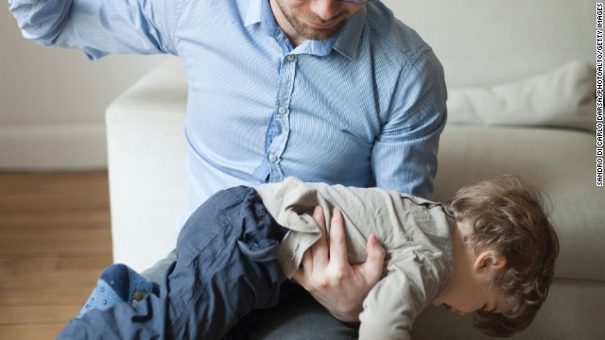
Definition of Spanking
Spanking is defined as hitting a child with an open hand and is used to control behavior.

Slide 4
Potential Negative Effects of Spanking
The Parenting theory tells us that spanking does not encourage healthy child development.
Spanking can affect areas of the brain that are responsible for learning and memory because spanking causes a child to be stressed.
Research has shown that severe spanking can cause aggressive behaviors no matter the amount of affection, comfort, concern, support, or nurturance you provide your child.

Slide 5
Internalizing Effects
Internally, child may experience the following:
Anxiety
Depression
Withdrawal

Slide 6
Externalizing Effects
Externally, the child might demonstrate the following:
Aggressive Behavior
Conduct Problems
Destructive Behavior

Slide 7
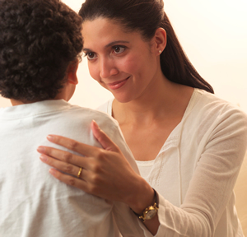
Characteristics of Effective Spanking
Not spanking before the age of 2.
-Appropriate ages to spank are between ages 2-6.
-Should phase out between ages 7-12.
2. Spanking should be under control.
-Not in rage, fury, or danger of “losing it” in anger.

Slide 8
Characteristics of Effective Spanking
3. Always used with reasoning.
-Clear explanations should be given to help avoid high levels of child distress.

Slide 9
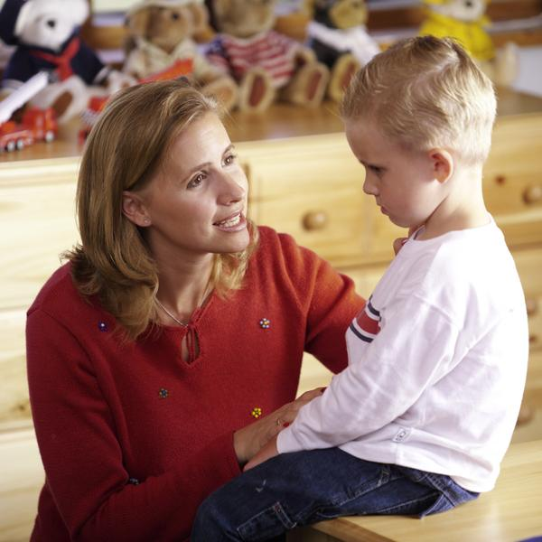
Characteristics of Effective Spanking
4. Always used privately.
-Child embarrassment should be avoided.

Slide 10
Characteristics of Effective Spanking
5. Motivated by genuine concern for the child.
-Spanking should never be motivated by parent-oriented concerns such as from sheer frustration or “showing who’s boss”.
6. The spanking should not be overly severe.
-Overly severe punishments indicate an overly severe parenting style.

Slide 11
Authoritarian Parenting
Parents who tend to be high on demand and low on warmth, use the parenting style called authoritarian parenting.
Authoritarian parenting example
Possible Outcomes for the Child:
More likely to behave aggressively.
More likely to have temperament problems.
More likely to have social anxiety and other social problems.

